Slide 1
Handwriting Recognition
Machine Learning based recognition
Arjun Chandrasekaran

Slide 2
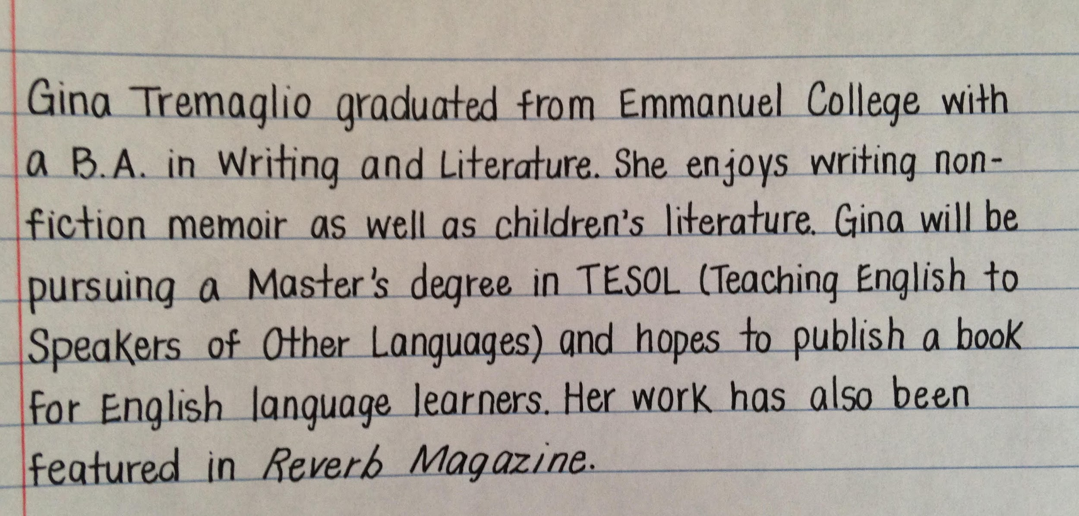
Description
The aim of this project is to gain the ability to convert handwritten text to editable digital format.
Using neural networks, a machine can be trained to recognize characters of many variations and output the correct result.

Slide 3

Purpose
Preserving handwritten notes
Converting old books to digital
We can use this recognition process as basis to expand on.
Translations
Content based image retrieval
Text-to-Speech

Slide 4
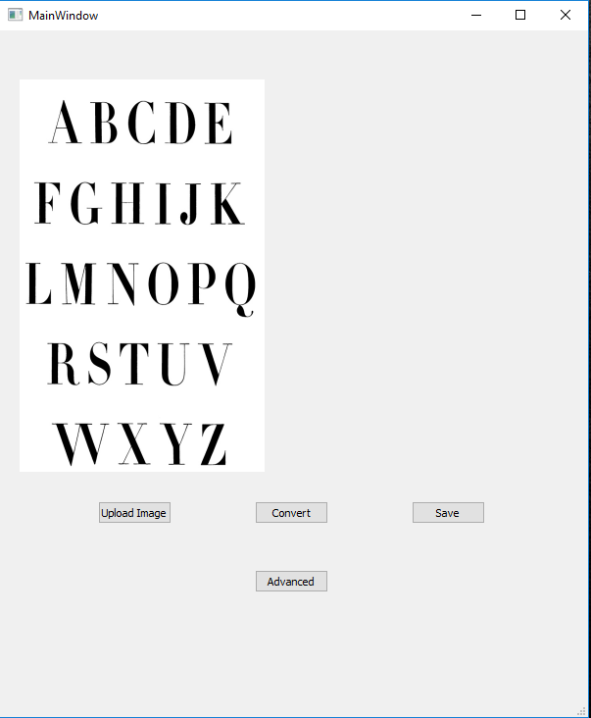
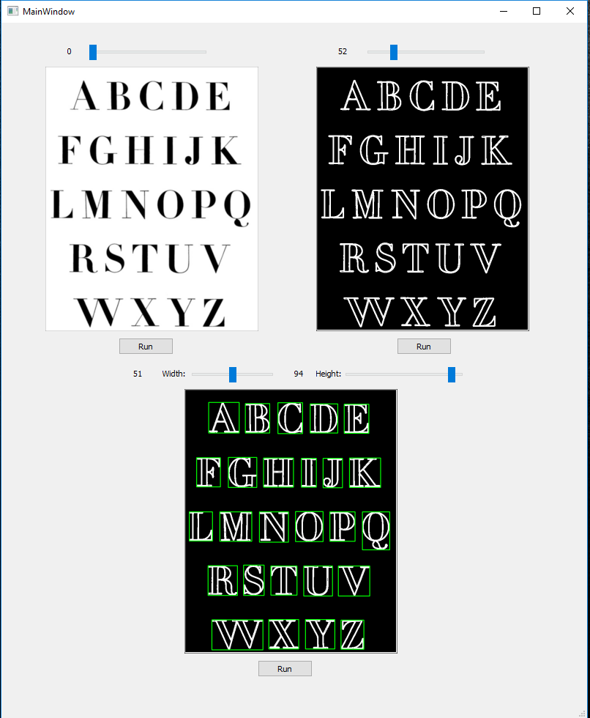
Functionality
Upload handwritten image
Save converted digital text
Advanced option
Sliders to optimize each stage of converting process

Slide 5
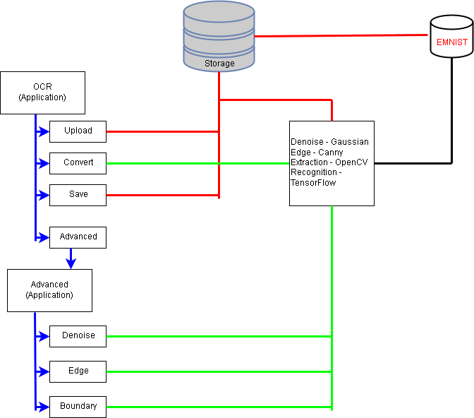
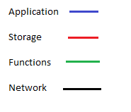
High Level Architecture

Slide 6
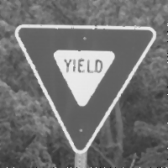
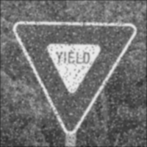
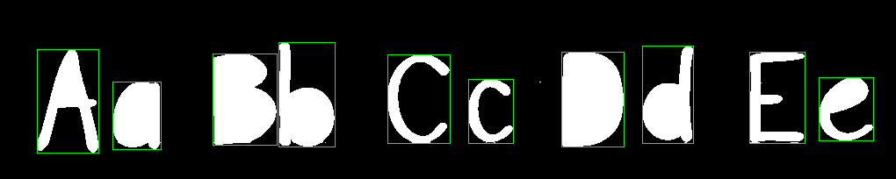
Advanced Functionality
Denoise - Pepper-Salt removal
Median Filter
Gaussian Blue
Edge Detection
Canny
Gaussian Blur
Sobel
Non Maximum Suppression
Double Threshold
Edge tracking
Bounding Box
Contours

Slide 7
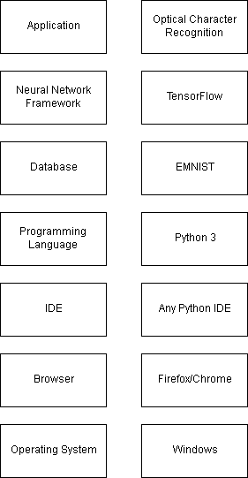
Technology Stack

Slide 8
DEMO

Slide 9
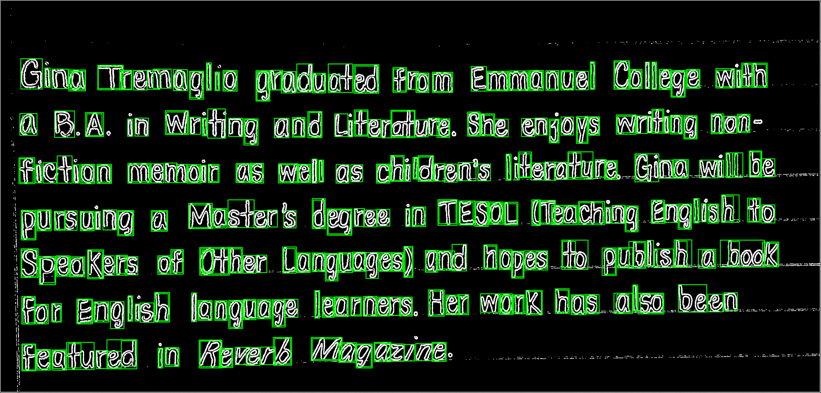

Slide 10
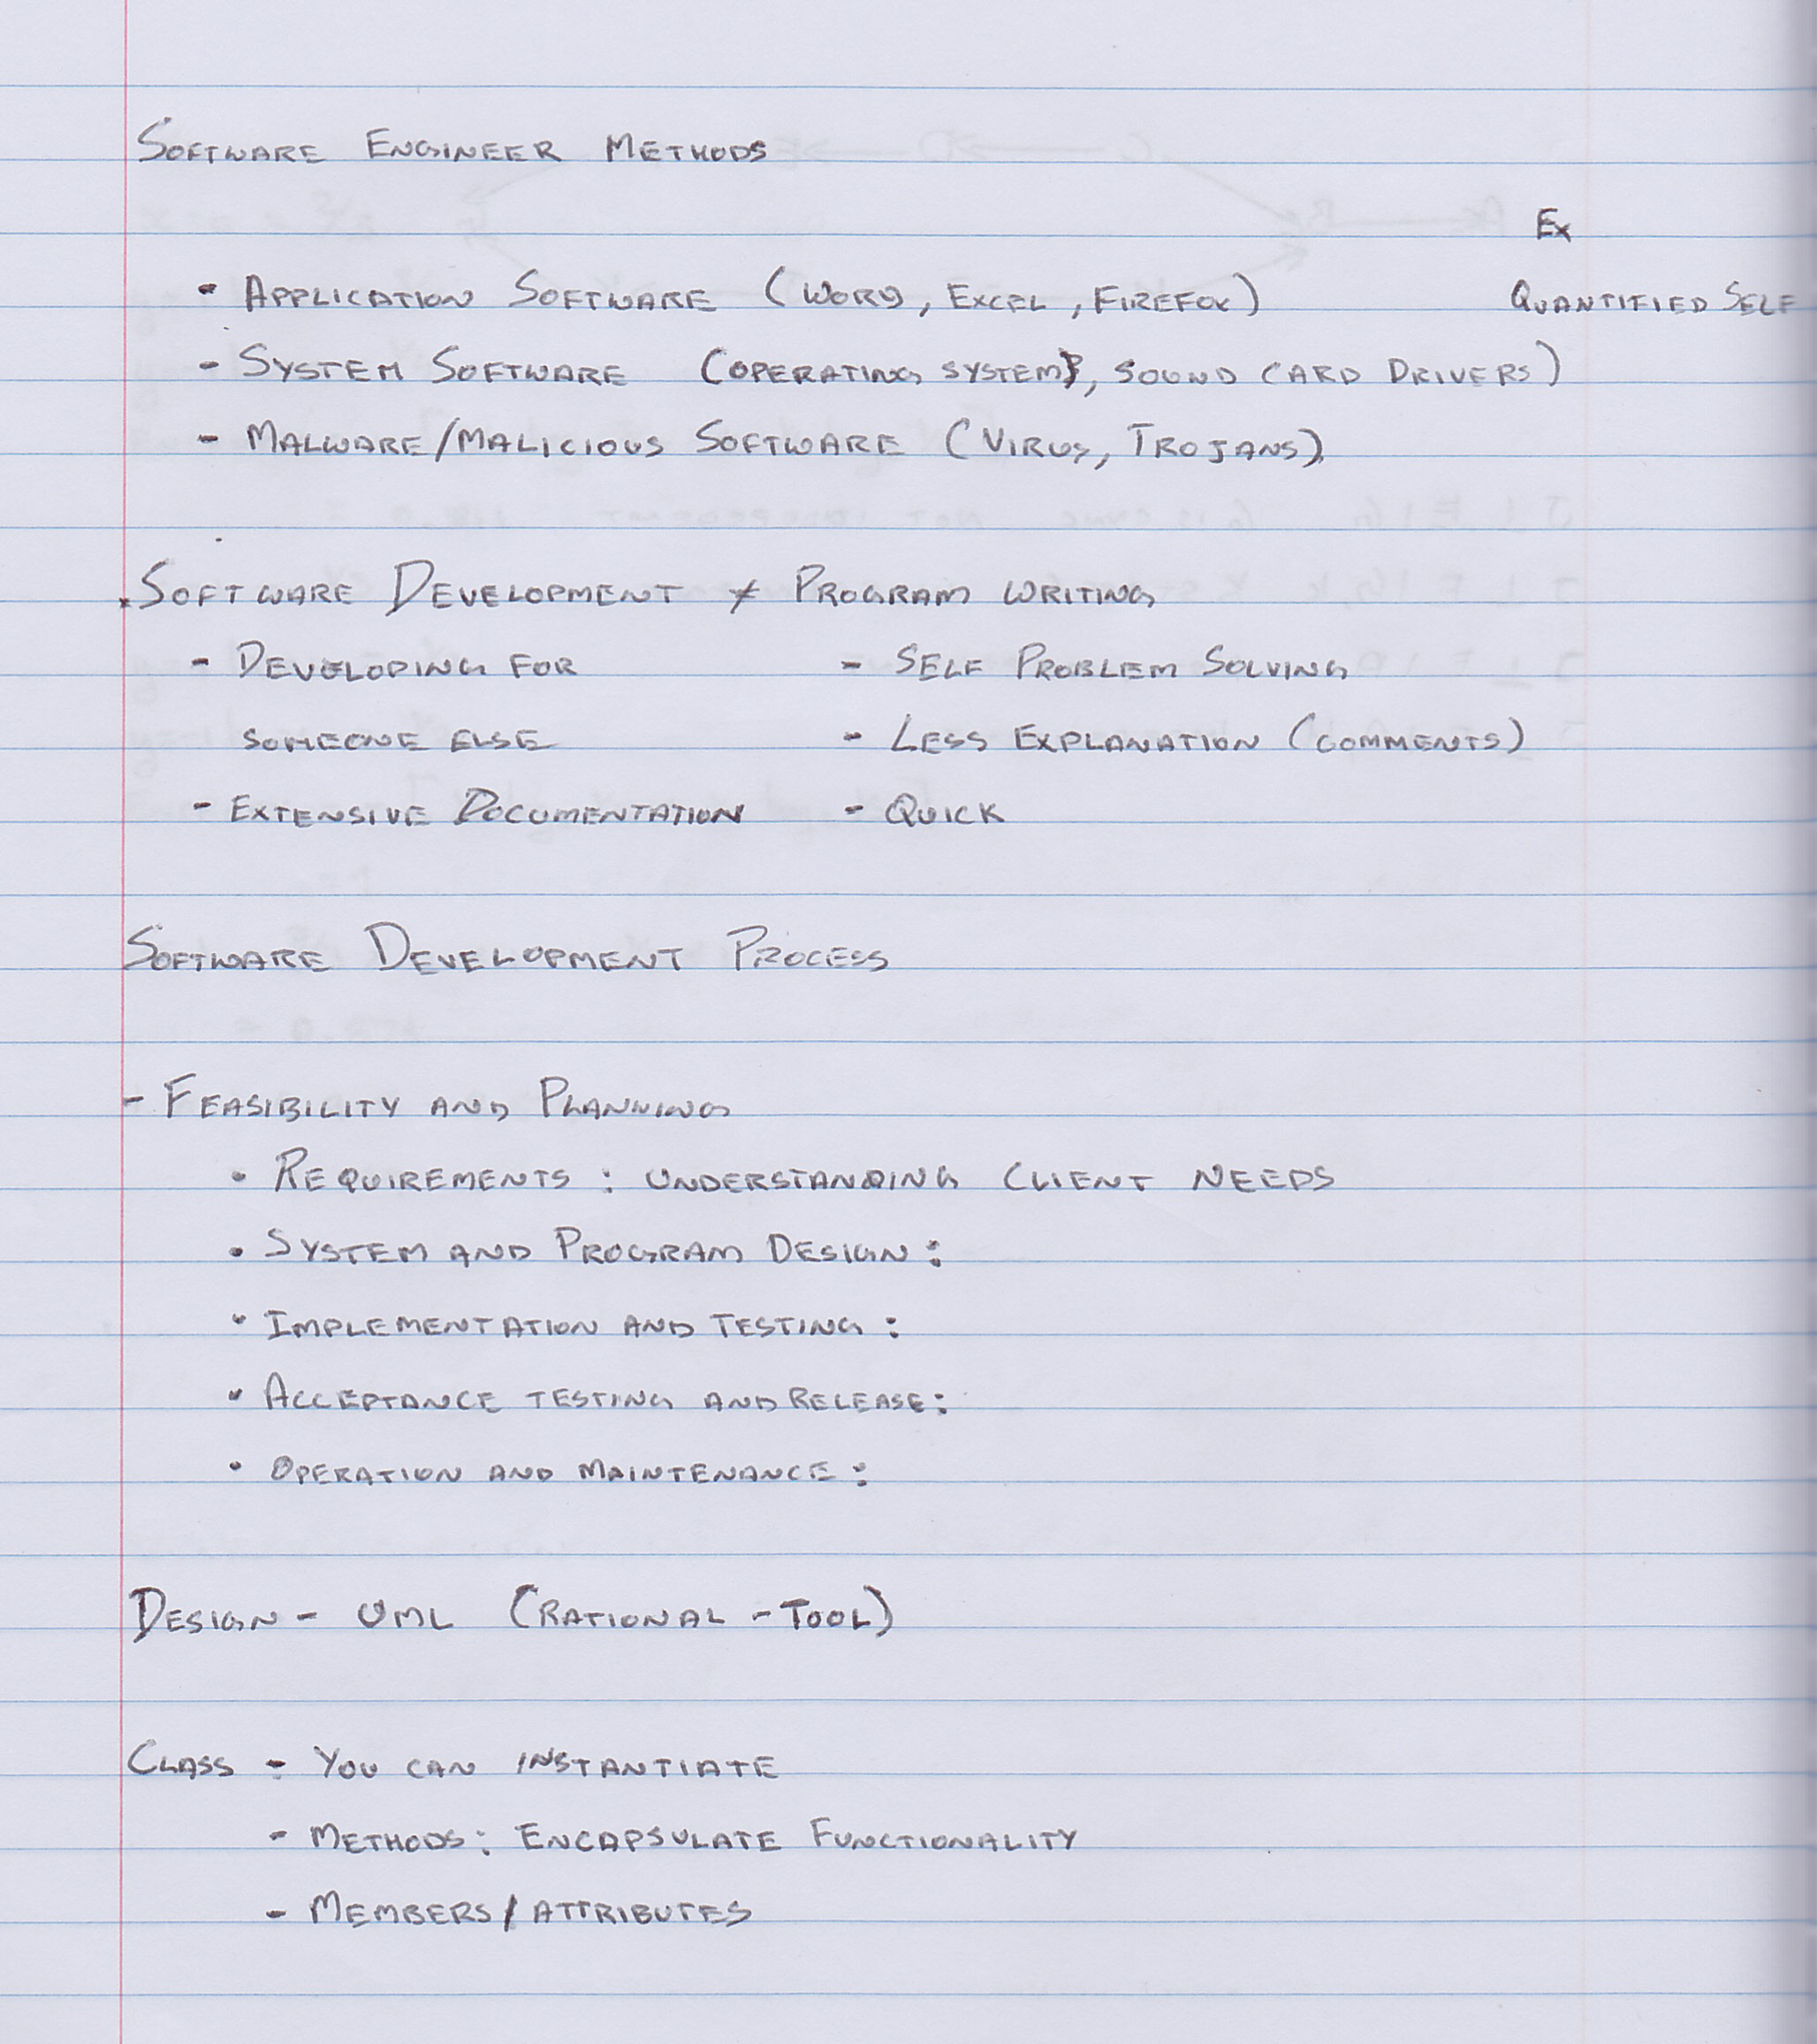
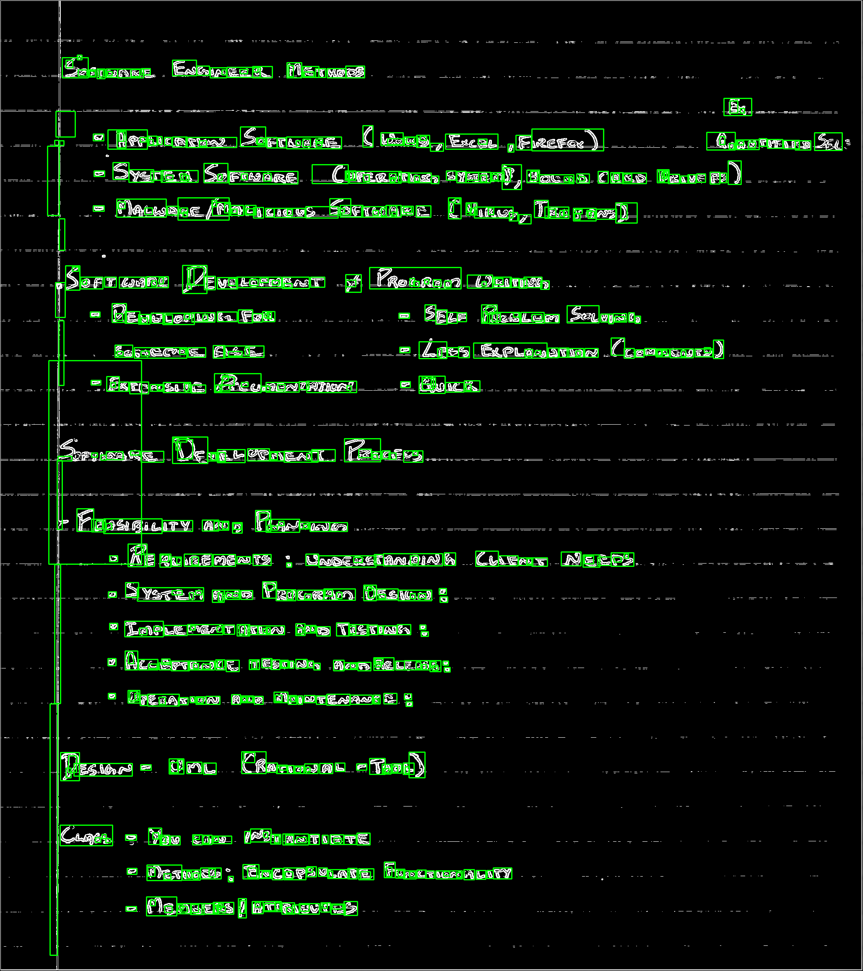

Slide 11
Issues Faced
Pre Processing Image
Edge Detection
Bounding Box
Character Recognition
Python3.7 Tensorflow
PyQt - Python Graphic Designer

Slide 12
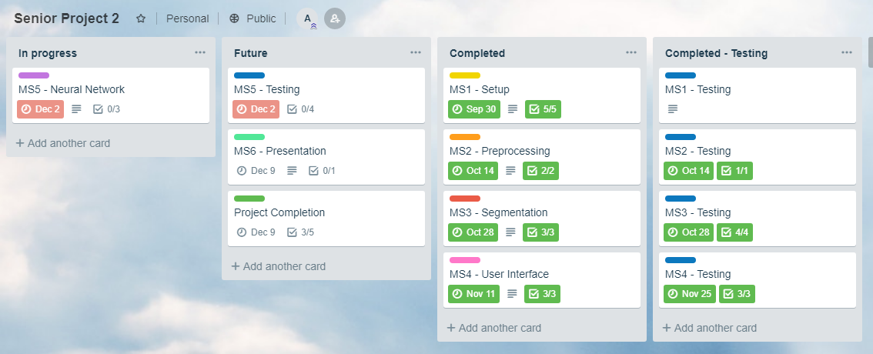
Trello
https://trello.com/b/pjc8djxl/senior-project-2

Slide 13
QA

